Slide 1




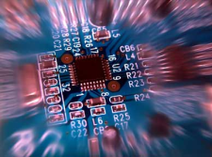


Protocols and Middleware to support Online Sensing/Actuation, Communication and Processing in the Internet Of Things Abdelghani Chibani LISSI Laboratory, Paris Est Créteil University, France

Slide 2
The benefits of data processing in IoT
Convert (billions of) smart meter readings to better predict and balance power consumption.
Analyze thousands of traffic, pollution, weather, congestion, public transport and event sensory data to provide better traffic and smart city management.
Monitor patients, elderly care and much more…
Requires: real-time, reliable, efficient (for low power and resource limited nodes), and scalable solutions.
Notes:
2

Slide 3
Sensor Data
The sensory data represents physical world observation and measurement and requires time and location and other descriptive attributes to make the data more meaningful.
For example, a temperature value of 15 degree will be more meaningful when it is described with spatial (e.g. Guildford city centre) and temporal (e.g. 8:15AM GMT, 21-03-2013), and unit (e.g. Celsius) attributes.
The sensory data can also include other detailed meta-data that describe quality or device related attributes (e.g. Precision, Accuracy).

Slide 4
Sensor Data
RAW Data: 15, C, 08:15, 51.243057, -0.589444
Formatting:
XML FORMAT
JSON
RDF

Slide 5
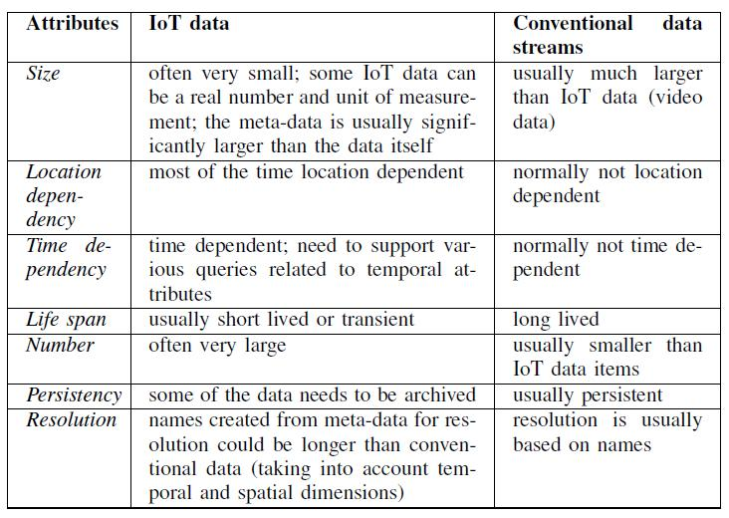
Comparing IoT data streams with conventional multimedia streams
Source: P. Barnaghi, W. Wang, L. Dong, C. Wang, "A Linked-data Model for Semantic Sensor Streams", in the Proc. of
IEEE International Conference on Internet of Things (iThings 2013), August 2013.

Slide 6
IoT Data Challenges
Interoperability: various data in different formats, from different sources (and different qualities)
Discovery: finding appropriate device and data sources
Access: Availability and (open) access to resources and data
Search: querying for data
Integration: dealing with heterogeneous device, networks and data
Interpretation: translating data to knowledge usable by people and applications
Scalability: dealing with large number of devices and myriad of data and computational complexity of interpreting the data.

Slide 7
IoT Data Transmission
Request/Answer, Push, Publish/Subscribe (long-term/short-term)
The typical types of Query and Subscription
ID (resource/service) – for known resources
Location
Type
Time – requests for freshness data or historical data;
One of the above + a range [+ Unit of Measurement]
Type/Location/Time + A combination of Quality of Information attributes
Event of interest
Feature of an entity on interest)
Complex Data Types (e.g. pollution data could be a combination of different types)

Slide 8
Protocols and Cloud Platforms
Application Level

Slide 9
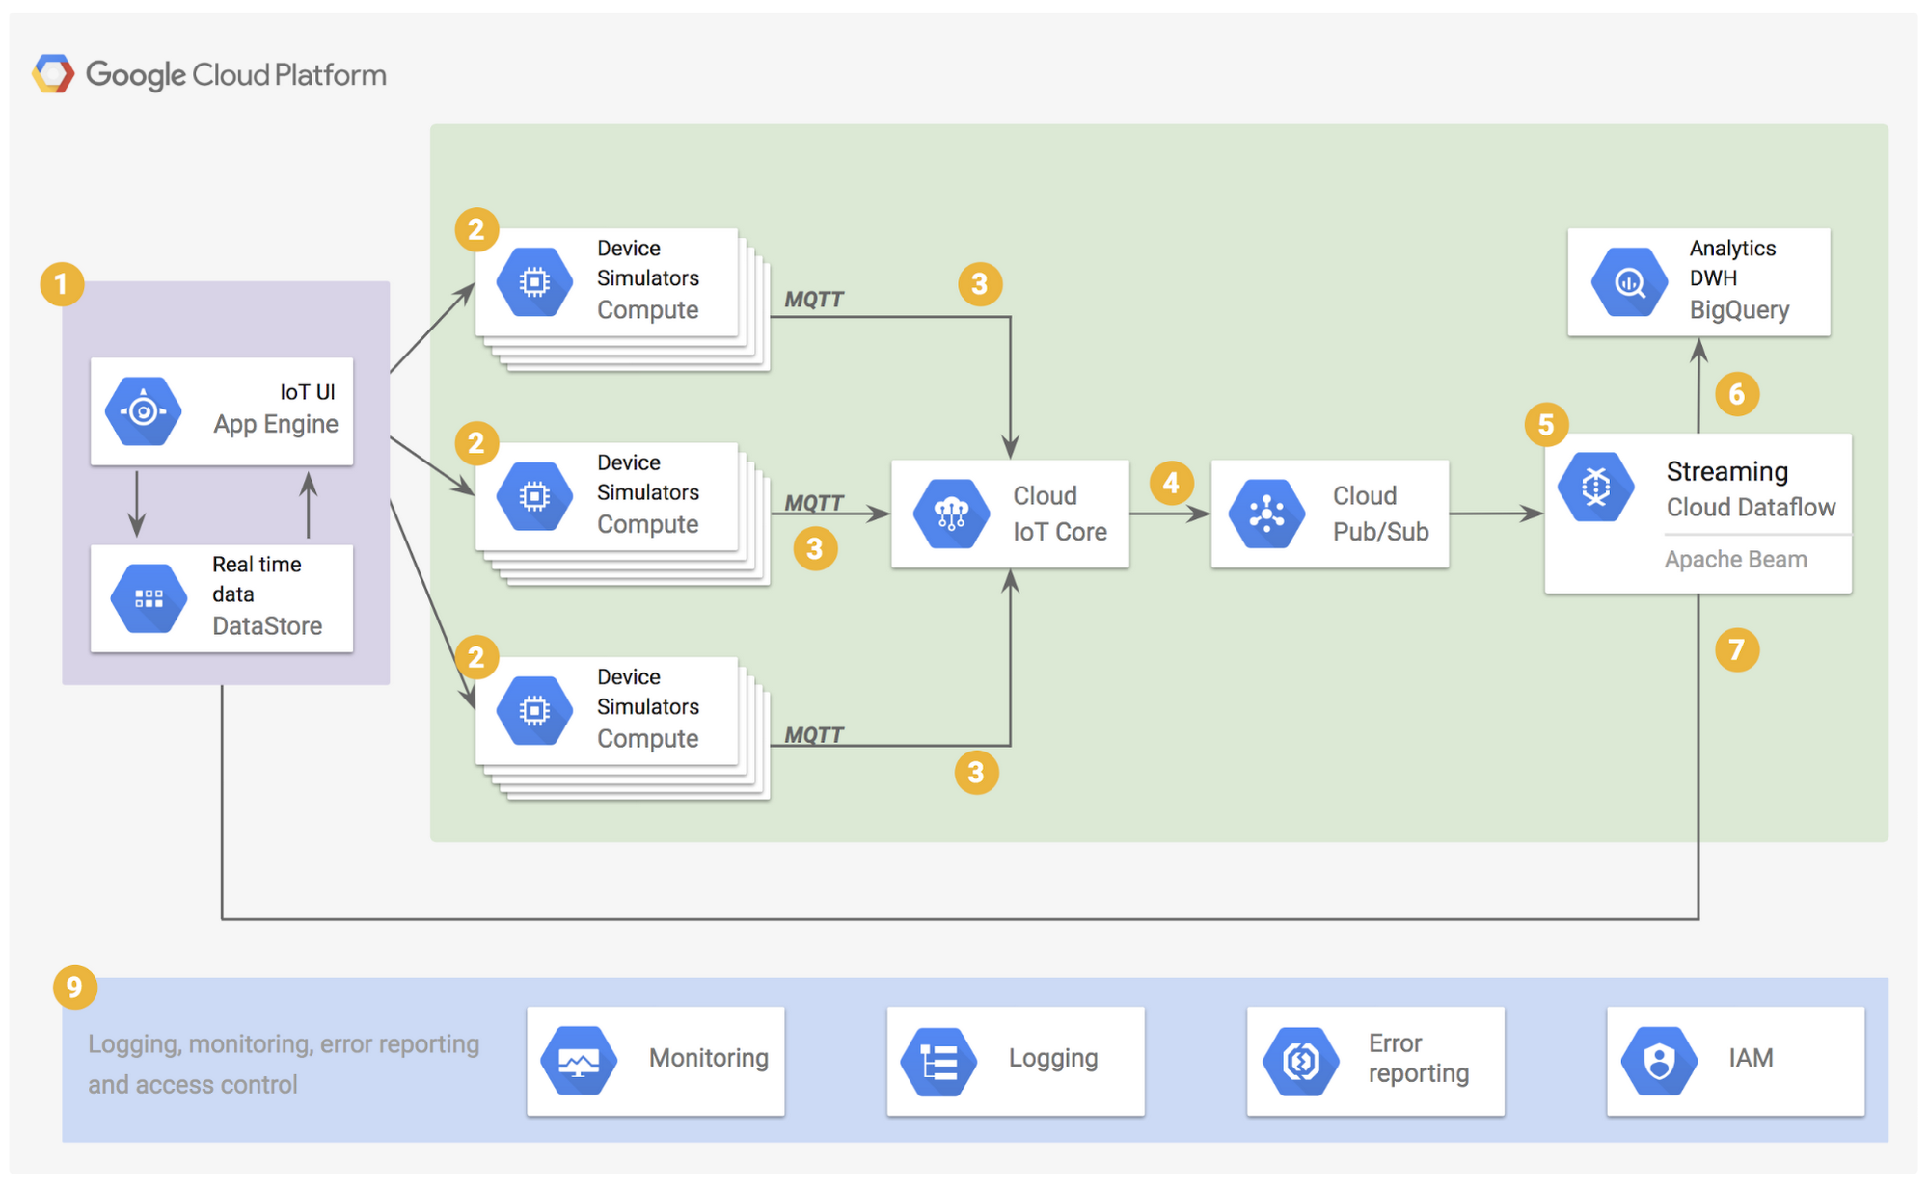
Google Cloud Platform (GCP)
https://cloud.google.com/blog/products/iot-devices/quick-and-easy-way-set-end-end-iot-solution-google-cloud-platform

Slide 10
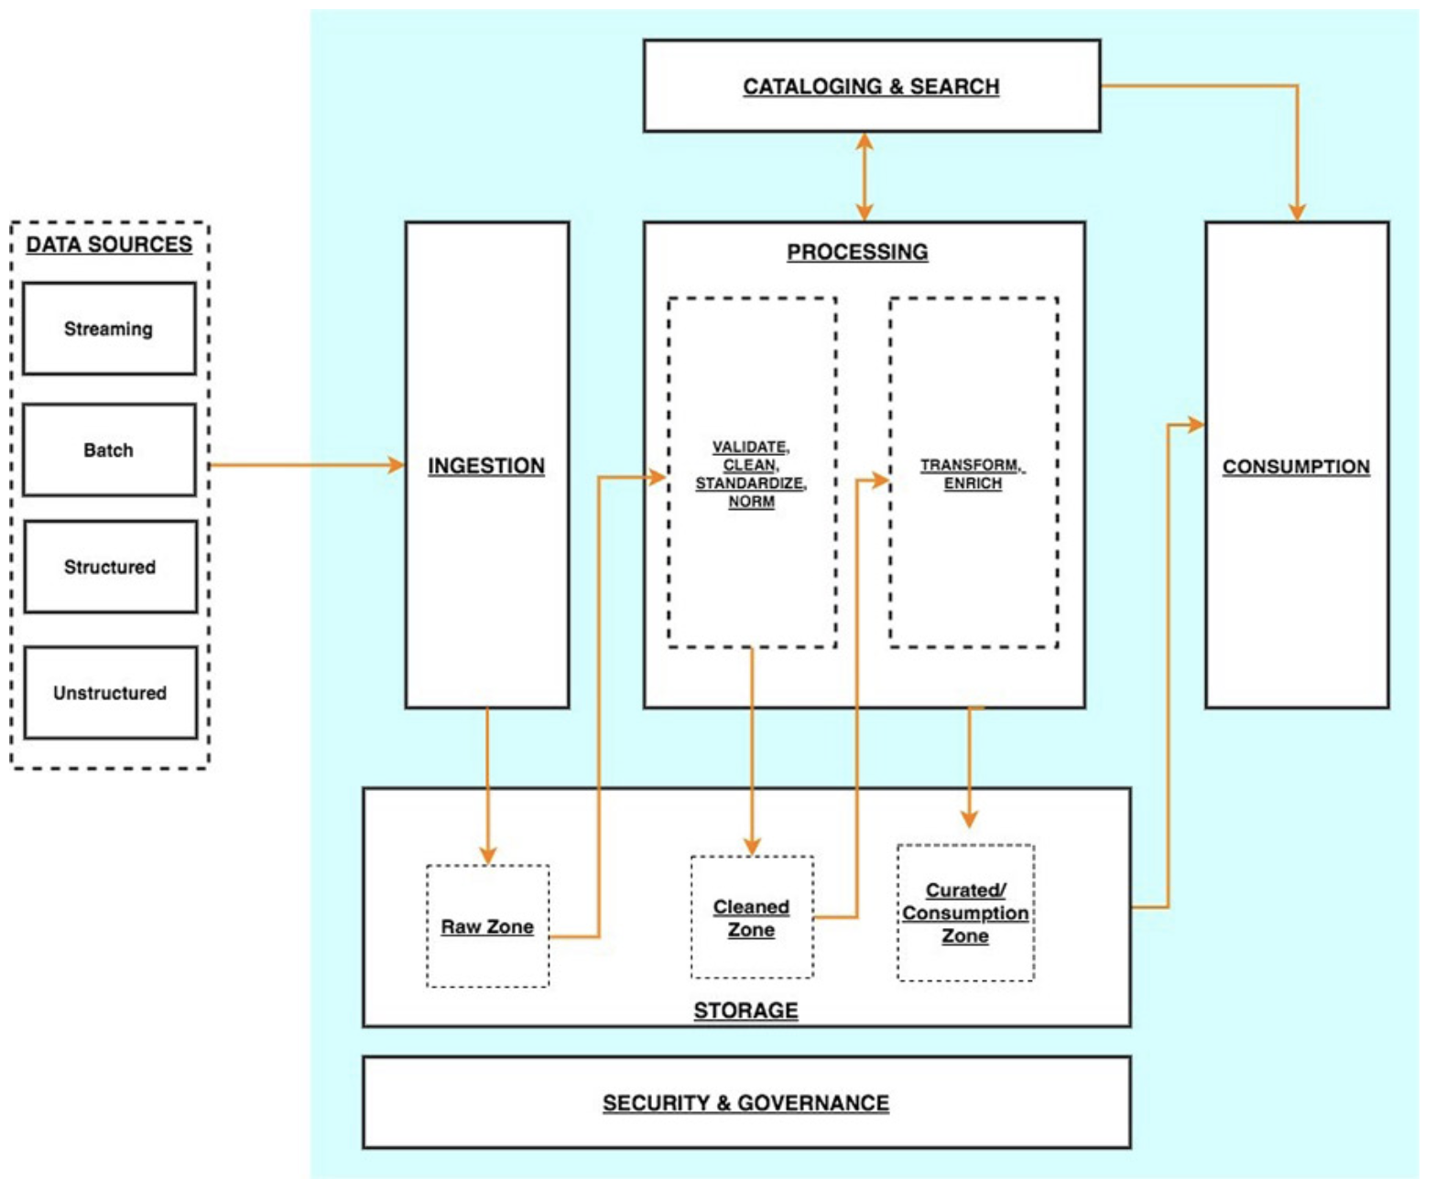
Amazon AWS

Slide 11
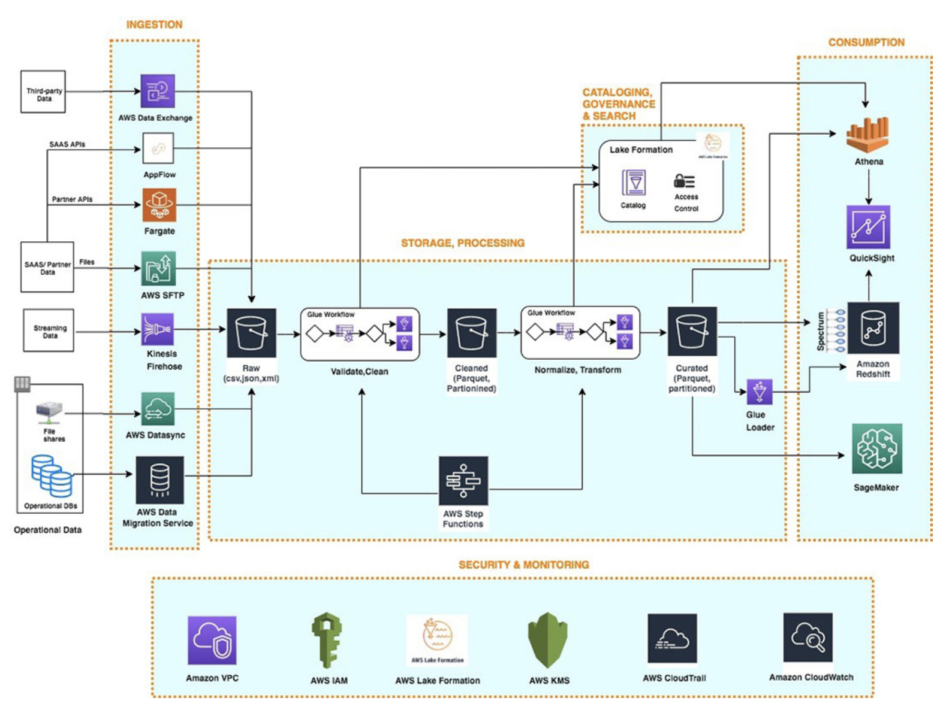
Amazon AWS

Slide 12
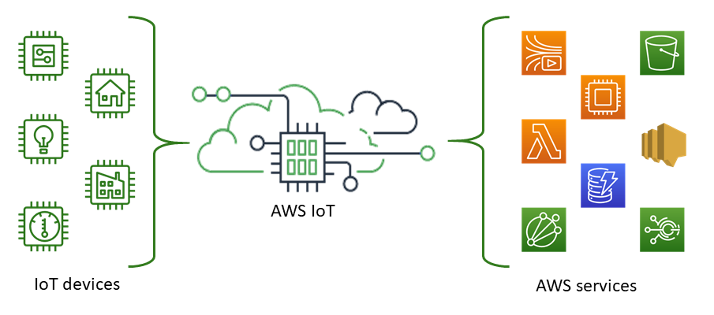
Amazon IOT
https://docs.aws.amazon.com/fr_fr/iot/latest/developerguide/what-is-aws-iot.html

Slide 13
IoT protocols landscape
HTTP
AMQP
MQTT
CoAP
XMPP
STOMP
DDS

Slide 14
OASIS MQTT - MQ Telemetry Transport for Message Queueing

Slide 15
Google Cloud Platform (GCP)
https://cloud.google.com/blog/products/iot-devices/quick-and-easy-way-set-end-end-iot-solution-google-cloud-platform

Slide 16
What is MQTT ?
MQTT = MQ Telemetry Transport
A way to obtain real world data
Information is gathered by an increasing number of sensors and devices deployed all over
A way to provide real time information
E.g. Locate an item in a supply chain
Accurate current load of a any system (e.g. electricity meters)
Current status of a system (level of liquid in a container, temperature, pressure etc.)
A way to connect all the devices and sensors directly to your messaging infrastructure

Slide 17
What is MQTT ?
Lightweight messaging protocol designed for sensors and devices with
Flaky network connectivity
Low computing power
Connections where bandwidth is at a premium
Protocol specification is open source
MQTT is nearly 10 years old
Mature and evolving

Slide 18
MQTT Architecture

Slide 19
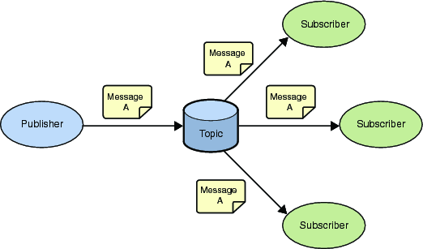
MQTT - Publish Subscribe Messaging aka One to Many
A Publish Subscribe messaging protocol allowing a message to be published once and multiple consumers (applications / devices) to receive the message providing decoupling between the producer and consumer(s)
A producer sends (publishes) a message (publication) on a topic (subject)
A consumer subscribes (makes a subscription) for messages on a topic (subject)
A message server / broker matches publications to subscriptions
If no matches the message is discarded
If one or more matches the message is delivered to each matching subscriber/consumer

Slide 20
MQTT - Publish Subscribe Messaging aka One to Many
A topic forms the namespace
Is hierarchical with each “sub topic” separated by a /
An example topic space
A house publishes information about itself on:
<country>/<region>/<town>/<postcode>/<house>/energyConsumption
<country>/<region>/<town>/<postcode>/<house>/solarEnergy
<country>/<region>/<town>/<postcode>/<house>/alarmState
<country>/<region>/<town>/<postcode>/<house>/alarmState
And subscribes for control commands:
<country>/<region>/<town>/<postcode>/<house>/thermostat/setTemp
A subscriber can subscribe to an absolute topic or can use wildcards:
Single-level wildcards “+” can appear anywhere in the topic string
Multi-level wildcards “#” must appear at the end of the string
Wildcards must be next to a separator
Cannot be used wildcards when publishing
For example
UK/Hants/Hursley/SO212JN/1/energyConsumption
Energy consumption for 1 house in Hursley
UK/Hants/Hursley/+/+/energyConsumption
Energy consumption for all houses in Hursley
UK/Hants/Hursley/SO212JN/#
Details of energy consumption, solar and alarm for all houses in SO212JN
A Publish Subscribe messaging protocol allowing a message to be published once and multiple consumers (applications / devices) to receive the message
Support loose coupling
Durable and non durable subscriptions
A publication may be retained
Wildcards must be next to a separator
Can't use wildcards when publishing

Slide 21
MQTT - Publish Subscribe Messaging aka One to Many
A subscription can be durable or non durable
Durable:
Once a subscription is in place a broker will forward matching messages to the subscriber:
Immediately if the subscriber is connected
If the subscriber is not connected messages are stored on the server/broker until the next time the subscriber connects
Non-durable: The subscription lifetime is the same as the time the subscriber is connected to the server / broker
A publication may be retained
A publisher can mark a publication as retained
The broker / server remembers the last known good message of a retained topic
The broker / server gives the last known good message to new subscribers
i.e. the new subscriber does not have to wait for a publisher to publish a message in order to receive its first message

Slide 22
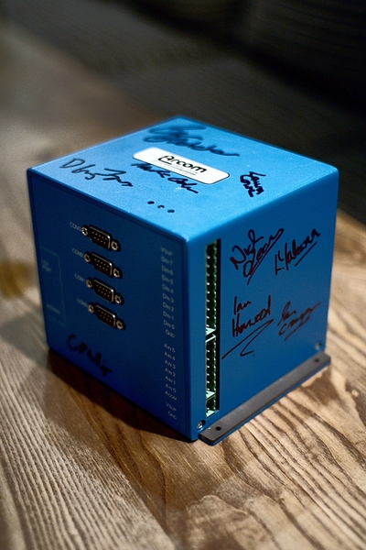
Use on Constrained Networks
Designed for constrained networks:
Protocol compressed into bit-wise headers and variable length fields.
Smallest possible packet size is 2 bytes
Asynchronous bidirectional “push” delivery of messages to applications (no polling)
Client to server and server to client
Supports always-connected and sometimes-connected models
Provides Session awareness
Configurable keep alive providing granular session awareness
“Last will and testament” enable applications to know when a client goes offline abnormally
Typically utilises TCP based networks e.g. Webscokets
Tested on many networks – vsat, gprs, 2G….
Provides multiple deterministic message delivery qualities of service
0 – message delivered at most once.
1 – message will be delivered but may be duplicated
2 – once and once only delivery
QOS maintained over fragile network even if connection breaks

Slide 23
Constrained Device
Designed for constrained devices:
Suited to applications / devices that may have limited resources available
8 Bit controllers upwards
Battery
Multiple MQTT client implementations available in many form factors / languages
Tiny footprint MQTT client (and server) libraries e.g. a c client lib in 30Kb and a Java lib in 64Kb

Slide 24
MQTT Client Implementations
C clients
Java clients
Java SE client
OSGi
Java ME / MIDP 2.0
MQTT Daemon
MQTT listener and bridge
Concentrator
Gateway to WebSphere MQ
Write your own !

Slide 25
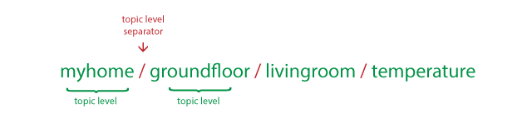
Channels in MQTT
Channels/topics in MQTT work like file paths
When subscribing to a channel we have to specify the whole path
Or use a wildcard
+
#

Slide 26

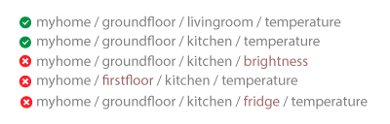
+ Wildcard

Slide 27

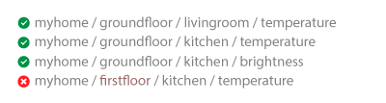
# Wildcard

Slide 28
MQTT flaws
Allows Injection
Allows full site sniffing.
Clear-text Passwords
Requires implementation of SSL/TLS and
other non-light weight technologies
No content type
Makes interoperability impossible
Makes integration and testing difficult.
No forwarding of identities.
Making security decisions difficult
Requires non-light weight security countermeasures to be added on-top.

Slide 29
XMPP Extensible Messaging and Presence Protocol)

Slide 30
What is XMPP?
eXtensible Messaging and Presence Protocol
Bi-directional streaming XML
Core: IETF RFC 3920, 3921
Extensions: XMPP Standards Foundation (XSF)
Membership-based
Elected technical council
Unit of work: XMPP Extension Protocol (XEP)
Process: Experimental, Proposed, Draft, Final
Goals:
Simple clients
Federate everything

Slide 31
XMPP potential for the IoT
Asynchronous messages, sent from one entity to another.
Request/Response, where one entity requests information from another, who responds once for each request.
Publish/Subscribe, where publishers publish information to a broker, which persists it, and later distributes it to a negotiated set of subscribers.
Multicasting, like Publish/Subscribe, but without data persistence.
Queues, to who Data providers push data when available, and where Consumers pull data, when they are ready.

Slide 32
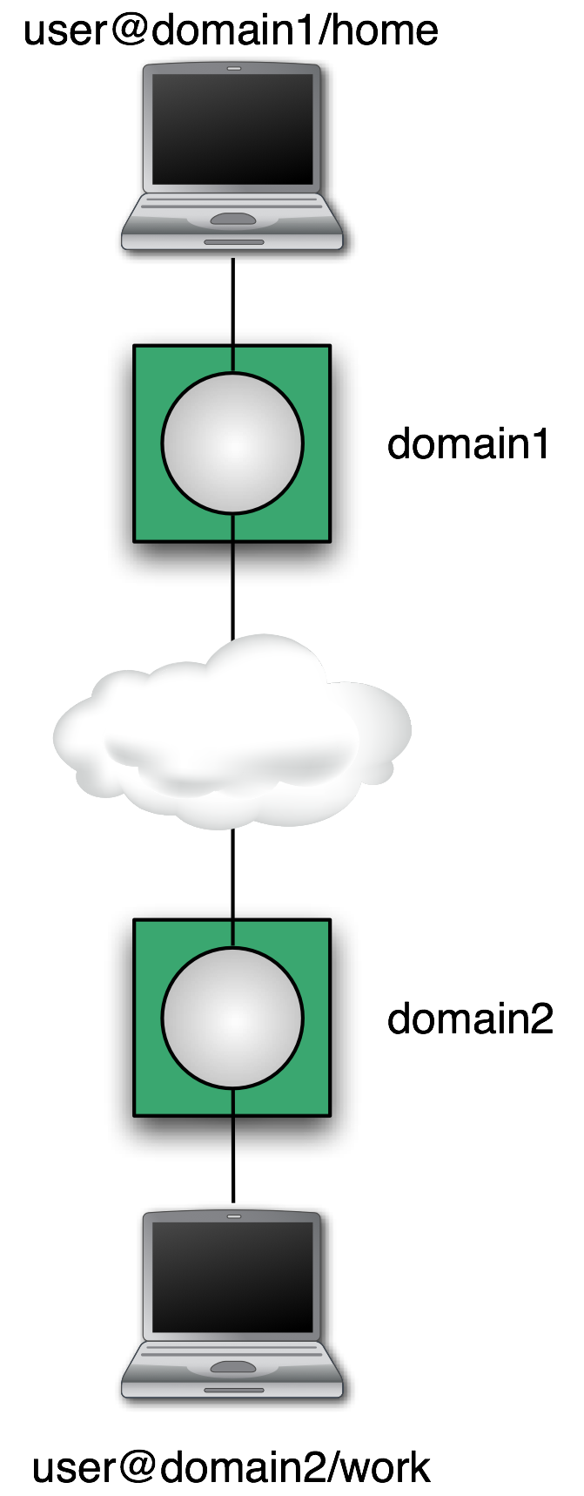
XMPP Architecture
Addressing Scheme: node@domain/resource
JID = Jabber ID
Node: identity, e.g. user name
Domain: DNS domain name
Resource: device identifier
node@domain identifies a person
Client talks to “local” server
Wherever the user account is hosted
Tied to directory if desired
Organizational policy enforced
Servers talk to other servers
DNS lookup on domain portion of address
Dialback, MTLS for security
One connection for many conversations

Slide 33











IoT Harmonization Using XMPP
XMPP
Device
CoAP
Device
XMPP
Broker
Bridge
CoAP
Device
CoAP
Device
XMPP
Device

Slide 34



















IoT Harmonization Using XMPP
Global Federated XMPP network
XMPP
Bridge
XMPP
bridge
XMPP
Bridge
T
H
I
Backend
3rd part API
N
G
system

Slide 35






IoT Harmonization Using XMPP
XMPP
Device
HTTP Island
MQTT Island
Federated global XMPP network
XMPP
Device
XMPP
Device
ZigBee (HTTP REST) Island
CoAP Island
XMPP
Device

Slide 36
XMPP Streams
Client connects TCP socket to server
Client sends stream start tag: <stream:stream xmlns='jabber:client' xmlns:stream='http://etherx.jabber.org/streams' to='example.com' version='1.0'>
Server sends stream start tag back: <stream:stream xmlns='jabber:client' xmlns:stream='http://etherx.jabber.org/streams' from='example.com’ id='someid' version='1.0'>
Each child element of stream a “stanza”
Note: NOT an element
Note: NOT an element

Slide 37
Stream features
After stream start, server sends feature list: <stream:features> <starttls xmlns='urn:ietf:params:xml:ns:xmpp-tls'/> <mechanisms xmlns='urn:ietf:params:xml:ns:xmpp-sasl'> <mechanism>DIGEST-MD5</mechanism> </mechanisms> <compression xmlns='http://jabber.org/features/compress'> <method>zlib</method> </compression> </stream:features>
Client can negotiate any of these features

Slide 38
Roster
Roster is the name given to the list of contacts which appears in one’s chat client. In Google Talk terms, it is the list of friends you would see once you login. The elements of the roster are your contacts. Each of these items is identified by a unique identifier called JID (Jabber Identifier).
Rosters are stored on the server so that the XMPP client may retrieve the same each time the user logs in.

Slide 39
XML Stanzas
From RFC 6120 4.1 Stream Fundamentals Definition of XML Stanza:
An XML stanza is the basic unit of meaning in XMPP.
A stanza is a first-level element (at depth=1 of the stream) whose element name is “message”, “presence”, or “iq” and whose qualifying namespace is ‘jabber:client’ or ‘jabbe…

Slide 40
Stanzas
All have to='JID' and from='JID' addresses
To gives destination
From added by local server
Each stanza routed separately
All contents of stanza passed along
Extend with any XML from your namespace
Different types for delivery semantics
<message/>: one direction, one recipient
<presence/>: one direction, publish to many
<iq/>: "info/query", request/response

Slide 41
Message
This is one of the three fundamental Stanzas in XMPP.
a Message Stanza is used for sending (Instant Messages).

Slide 42
Message
Example: <message xml:lang='en' to='romeo@example.net' from='juliet@example.com/balcony' type='chat'> <body>Wherefore art thou, Romeo?</body> </message>
Types: chat, groupchat, headline, error
Body: plain text
XHTML IM: XEP-0071

Slide 43
IQ (Info/Query)
Another very important Stanza.
It is similar to traditional Request/Response paradigms such as HTTP.
An IQ Stanza can be one of four types,
“get”, “set”→ requests or queries
“result” or “error” → responses or information.
An IQ Stanza can wrap various kinds of elements.
Example.
Alice logs onto her XMPP client.
The client sends an XMPP IQ Stanza of type “get” to Openfire server requesting her roster.
<iq from=”Alice@gmail.com” type=”get” id=”roster_1″> <query xmlns=”jabber:iq:roster”/> </iq>

Slide 44
IQ Request
Example: <iq type='get' id='roster_1'> <query xmlns='jabber:iq:roster'/> </iq>
Type: get, set, result, error
ID: track the corresponding response
Query/Namespace: what type of request?

Slide 45
IQ Response (Roster)
Example: <iq type='result' id='roster_1'> <query xmlns='jabber:iq:roster'> <item jid='romeo@example.net' name='Romeo' subscription='both'> <group>Friends</group> </item> </query> </iq>
Type: response
ID matches request
Subscription state: none, to, from, both

Slide 46
Presence
This is the third Stanza type specified by XMPP Core.
Presence simply refers to the availability or status of a contact.

Slide 47
Presence
Example: <presence> <show>dnd</show> <status>Meeting</status> <priority>1</priority> </presence>
Show: chat, available, away, xa, dnd
Status: Human-readable text
Priority: Which resource "most available"?

Slide 48
Subscribing to Presence
Send a subscription request: <presence to='juliet@example.com' type='subscribe'/>
Approving a request: <presence to='romeo@example.net' type='subscribed'/>
Every time you change a subscription, you get a "roster push": <iq type='set'> <query xmlns='jabber:iq:roster'> <item jid='romeo@example.net' subscription='from'/> </query> </iq>

Slide 49
Java Example 1/2
import org.jivesoftware.smack.*
public class TestXMPP {
public static void main(String[] args) {
// Create the configuration for this new connection
ConnectionConfiguration config = new ConnectionConfiguration("127.0.0.1");
XMPPConnection connection = new XMPPConnection(config);
// Connect to the server
try {
connection.connect();
// Log into the server
connection.login("test", "test");
} catch (XMPPException e) {
e.printStackTrace();
}

Slide 50
Java Example 2/2
// Write a message to a friend
Message msg = new Message("friend JID", Message.Type.chat);
msg.setBody("Hello my friend!");
connection.sendPacket(msg);
System.out.println("Sent to 'my friend'> Hello my friend!");
}
}

Slide 51
Extensibility Example: Message
Use a new namespace
Key: if you don't understand it, ignore it
Example, CAP, XEP-0127: <message to='weatherbot@jabber.org' from='KSTO@NWS.NOAA.GOV'> <alert xmlns='http://www.incident.com/cap/1.0'> <identifier>KSTO1055887203</identifier> <sent>2003-06-17T14:57:00-07:00</sent> <info> <category>Met</category> <event>SEVERE THUNDERSTORM</event> ... </info> </alert> </message>

Slide 52
Extensibility Example: Presence
Keep presence stanzas small
Example: Entity Capabilities, XEP-0115: <presence from='bard@shakespeare.lit/globe'> <c xmlns='http://jabber.org/protocol/caps' hash='sha-1' node='http://www.chatopus.com' ver='zHyEOgxTrkpSdGcQKH8EFPLsriY='/> </presence>
Ver attribute is hash of all features of this client
Hash -> Feature list is cached

Slide 53
Security of XMPP
Start-TLS
Prove the identity of the server
Prove the identity of the user (optional)
Encryption
Data integrity
SASL (RFC 4422)
Authentication
Optional encryption (rarely used)
Pluggable (e.g. passwords, Kerberos, X.509, SAML, etc.)

Slide 54
Federation: Security
Old-style: dialback
Connect back to domain claimed by initiator
Check secret claimed by initiator
"Someone said they were example.com; was that you?"
New-style: Mutual TLS
Initiator presents "client" certificate
Responder presents "server" certificate
Both certificates signed by trusted CA
All stanzas must have from with correct domain

Slide 55
Bandwidth minimization
TLS compression
Not implemented in all SSL/TLS stacks
Some want compression w/o encryption
XEP-0138: Stream Compression
Defines zlib mechanism (2-3x or more compression)
Others can be added
Concern: battery drain vs. radio transmission
XEP-0198: Stanza Acknowledgements
Quick reconnects
Avoid re-synchronizing state on startup
Partial rosters
Privacy lists
Others being pursued

Slide 56
Latency
Most critical on startup
Several handshakes and stream restarts
Can be minimized by client assuming server configuration
Example: don't wait for <stream:features>
Once running
Stanza size matters: try to stay under 8kB, take larger blocks out of band if possible
Configure federation to keep links open, first stanza will be slow
Beware of DoS protection, "karma"

Slide 57
XMPP Extensions
Many already exist: http://www.xmpp.org/extensions/
Add new ones
Custom: use a namespace you control, make up protocol
Standardized: write a XEP. It's straightforward, and we'll help

Slide 58
XEPs for the IoT
XEP-0323: Internet of Things - Sensor Data
XEP-0325: Internet of Things – Control
XEP-0347: Internet of Things – Discovery
XEP-0324: Internet of Things - Provisioning

Slide 59
XMPP implementation for the IoT
In Current XMPP implementations
Single server per MUC is single point of control
Stanzas aren't framed or reliably delivered
XMPP stacks are not easy to implement in a web environment
XML is needlessly verbose and unwieldy
The baseline feature-set is too minimal
JIDs haven't taken off like Email or MSISDNs
Not designed for mobile use cases (e.g. push; low bw)
Well documented spam and identity/security issues

Slide 60
Important Features of an IoT Messaging Protocol

Slide 61
Important Features of an IoT Messaging Protocol
UBIQUITOUS AND PERVASIVE
Open internet protocol standard
Binary WIRE protocol so that it can be ubiquitous, fast, embedded
Unambiguous core functionality for business message routing and delivery within Internet infrastructure
Scalable, so that it can be a basis for high performance fault-tolerant lossless messaging infrastructure, i.e without requiring other messaging technology
Fits into existing enterprise messaging applications environments in a practical way

Slide 62
Important Features of an IoT Messaging Protocol
UBIQUITOUS AND PERVASIVE
SAFETY
Infrastructure for a secure and trusted global transaction network
Consisting of business messages that are tamper proof
Supporting message durability independent of receivers being connected
Transport business transactions of any financial value
Sender and Receiver are mutually agreed upon counter parties
No possibility for injection of Spam

Slide 63
Important Features of an IoT Messaging Protocol
UBIQUITOUS AND PERVASIVE
SAFETY
FIDELITY
Well-stated message queuing and delivery semantics covering
at-most-once
at-least-once
and once-and-only-once (e.g. 'reliable’, ‘assured’, ‘guaranteed’)
Well-stated message ordering semantics describing what a sender can expect
a receiver to observe
a queue manager to observe
Well-stated reliable failure semantics
so exceptions can be managed

Slide 64
Important Features of an IoT Messaging Protocol
UBIQUITOUS AND PERVASIVE
SAFETY
FIDELITY
UNIFIED
Unified business messaging tool for inter domain communications
Global addressing standardizing end-to-end delivery across any network scope
Any object can initiate communication with, and then communicate with, any objet or broker over UDP/IP or TCP/IP
Optionally, extendable to alternate transports via negotiation
Provide a core set of messaging patterns via a single manageable protocol:
asynchronous directed messaging
request/reply, publish/subscribe
store-and-forward
Provide for Hub-and-Spoke messaging topology within and across business boundaries
Provide for Hub-to-Hub message relay across business boundaries through enactment of explicit agreements between broker authorities

Slide 65
Important Features of an IoT Messaging Protocol
UBIQUITOUS AND PERVASIVE
SAFETY
FIDELITY
UNIFIED
INTEROPERABILITY
Multiple stable and interoperating broker/device implementations
Each with a completely independent provenance (min. 2 to move to Final)
Each broker implementation is conformant with the specification, for all mandatory functionality, including fidelity semantics
Stable extended (broker-broker) wire protocol so that brokers do not require upgrade during 1.x feature evolution: Any two brokers versions 1.x, 1.y can communicate using protocol 1.x if x<y
Layered architecture, so features & network transports can be independently extended by separated communities of use

Slide 66
Important Features of an IoT Messaging Protocol
UBIQUITOUS AND PERVASIVE
SAFETY
FIDELITY
UNIFIED
INTEROPERABILITY
MANAGEABLE
Decentralized deployment with independent local governance
Intermediated: supports routing and relay management, traffic flow management and quality of service management
Interaction with the message delivery system is possible, sufficient to integrate with prevailing business operations that administer messaging systems using management standards.

Slide 67
Important Features of an IoT Messaging Protocol
…
SECURITY
SSL support
Service Context (incl. Security Context):
A standard Message property for for propagation of Security Tokens
Support for carrying Security Tokens:
Principal-ID, SAML, Kerberos ticket, etc.
Carried within the Service Context in the Message
Unique Security Token per Message:
Enables multiplexing of different Security Contexts on a given messaging session (e.g. for proxying)
Hash and sign of Message (including Security Context)
Assure authenticity of the contents in addition to encryption (content verified by final-destination).
Full-path privacy for business transactions that might pass through a number of hubs enroute to the final destination, where you would not want to have the exposed content of the message sitting in some queue and disk along the way.
Chains of trust within trust realms - optional

Slide 68
Service Oriented Architectures Vs Enterprise Messaging Bus (Micro Services)

Slide 69
What is Middleware?
Layer between OS and distributed applications
Hides complexity and heterogeneity of distributed system
Bridges gap between low-level OS communications and programming language abstractions
Provides common programming abstraction and infrastructure for distributed applications
Overview at: http://www.middleware.org
Distributed Applications
Distributed Applications
Distributed Applications
Middleware
(remote calls, object invocation, messages, …)
Operating System Comms
Operating System Comms
Operating System Comms
(sockets, IP, TCP, UDP, …)
Network
Network
Network
(packets, bits…)

Slide 70
What is Middleware?
Middleware provides support for (some of):
Naming, Location, Service discovery, Replication
Protocol handling, Communication faults, QoS
Synchronisation, Concurrency, Transactions, Storage
Access control, Authentication
Middleware dimensions:
Request/Reply vs. Asynchronous Messaging
Language-specific vs. Language-independent
Proprietary vs. Standards-based
Small-scale vs. Large-scale
Tightly-coupled vs. Loosely-coupled components

Slide 71
Remote Procedure Call (RPC)
Masks remote function calls as being local
Client/server model
Request/reply paradigm usually implemented with message passing in RPC service
Marshalling of function parameters and return value
Caller
RPC Service
RPC Service
Remote
Function
1) Marshal args
2) Generate ID
3) Start timer
message
4) Unmarshal
5) Record ID
call(…)
fun(…)
8) Unmarshal
9) Acknowledge
6) Marshal
7) Set timer

Slide 72
Properties of RPC
Language-level pattern of function call
easy to understand for programmer
Synchronous request/reply interaction
natural from a programming language point-of-view
matches replies to requests
built in synchronisation of requests and replies
Distribution transparency (in the no-failure case)
hides the complexity of a distributed system
Various reliability guarantees
deals with some distributed systems aspects of failure

Slide 73
Failure Modes of RPC
Invocation semantics supported by RPC in the light of:
network and/or server congestion,
client, network and/or server failure
note DS independent failure modes
RPC systems differ, many examples, local was Mayflower
Maybe or at most once (RPC system tries once)
Error return – programmer may retry
Exactly once (RPC system retries a few times)
Hard error return – some failure most likely
note that “exactly once” cannot be guaranteed

Slide 74
Disadvantages of RPC
Synchronous request/reply interaction
tight coupling between client and server
client may block for a long time if server loaded
leads to multi-threaded programming at client
slow/failed clients may delay servers when replying
multi-threading essential at servers
Distribution Transparency
Not possible to mask all problems
RPC paradigm is not object-oriented
invoke functions on servers as opposed to methods on objects
fork(…)
remote call
join(…)

Slide 75
Object-Oriented Middleware (OOM)
Objects can be local or remote
Object references can be local or remote
Remote objects have visible remote interfaces
Masks remote objects as being local using proxy objects
Remote method invocation
local
OOM
OOM
remote
object
request
broker
/
object
manager
object
request
broker
/
object
manager
object A
skeleton
object B
proxy
object B
object B

Slide 76
Properties of OOM
Support for object-oriented programming model
objects, methods, interfaces, encapsulation, …
exceptions (were also in some RPC systems e.g. Mayflower)
Synchronous request/reply interaction
same as RPC
Location Transparency
system (ORB) maps object references to locations
Services comprising multiple servers are easier to build with OOM
RPC programming is in terms of server-interface (operation)
RPC system looks up server address in a location service

Slide 77
CORBA
Common Object Request Broker Architecture
Open standard by the OMG (Version 3.0)
Language- and platform independent
Object Request Broker (ORB)
General Inter-ORB Protocol (GIOP) for communication
Interoperable Object References (IOR) contain object location
CORBA Interface Definition Language (IDL)
Stubs (proxies) and skeletons created by IDL compiler
Dynamic remote method invocation
Interface Repository
Querying existing remote interfaces
Implementation Repository
Activating remote objects on demand

Slide 78
Disadvantages of OOM
Synchronous request/reply interaction only
So CORBA oneway semantics added and -
Asynchronous Method Invocation (AMI)
But implementations may not be loosely coupled
Distributed garbage collection
Releasing memory for unused remote objects
OOM rather static and heavy-weight
Bad for ubiquitous systems and embedded devices

Slide 79
Web Services
Definition from W3C
“ A Web service is a software system identified by a URI, whose public interfaces and bindings are defined and described using XML. Its definition can be discovered by other software systems. These systems may then interact with the Web service in a manner prescribed by its definition, using XML based messages conveyed by internet protocols.”
Notes:
Our definition of the term "Web services" does not presuppose the use of SOAP as a packaging format or a processing model. Nor does it presuppose the use of WSDL as a service description language. There are, and will be in the future, plenty of Web services that use raw HTTP as a data transfer protocol and some mutually agreed-upon XML format as the message content. The Web Services *reference architecture* does, however, assume that the higher levels of the Web services protocol stack are built on the foundation of SOAP and WSDL.

Slide 80
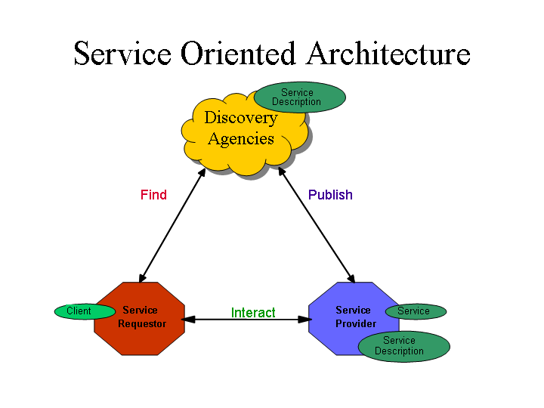
Service Oriented Architectures
Role
Technologies capable of:
Exchanging messages
Describing Web services
Publishing and discovering Web service descriptions
service requestor retrieves a service description
A service publishes its description
Operation
One-way, conversational, many-to-many
Component
Notes:
Components
The Service: Whereas a web service is an interface described by a service description, its implementation is the service. A service is a software module deployed on network accessible platforms provided by the service provider. It exists to be invoked by or to interact with a service requestor. It may also function as a requestor, using other web services in its implementation.
The Service Description: The service description contains the details of the interface and implementation of the service. This includes its data types, operations, binding information, and network location. It could also include categorization and other meta data to facilitate discovery and utilization by requestors. The complete description may be realized as a set of XML description documents. The service description may be published to a requestor directly or to a discovery agency.
Publish: In order to be accessible, a service needs to publish its description such that the requestor can subsequently find it. Where it is published can vary depending upon the requirements of the application (see Service Publication Stack discussion for more details)
Find: In the find operation, the service requestor retrieves a service description directly or queries the registry for the type of service required (see Service Discovery for more details). The find operation may be involved in two different lifecycle phases for the service requestor: at design time in order to retrieve the service's interface description for program development, and at runtime in order to retrieve the service's binding and location description for invocation.
Interact: Eventually, a service needs to be invoked. In the interact operation the service requestor invokes or initiates an interaction with the service at runtime using the binding details in the service description to locate, contact, and invoke the service. Examples of the interaction include: single message one way, broadcast from requester to many services, a multi message conversation, or a business process. Any of these types of interactions can be synchronous or asynchronous.

Slide 81
Web Services – Architectural Extensions
Incorporates additional features and functionality by extending technologies and components defined within the basic architecture, such as:
Asynchronous messaging
Attachment – typical usage : associating binary data with SOAP messages.
Caching
Message exchange pattern (MEP) - Describes a generalized pattern of message exchange between two services. e.g. : one-way, request/response, publish/subscribe, and broadcast.
Reliable message - implementation of Reliable Messaging one MEP is a series of requests between two nodes with an acknowledgement SOAP Module.
Message confidentiality – Can transmit the message via SSL or TLS, or have a SOAP Module provides for encryption and decryption.
Message integrity – Can have a SOAP Module use digital signature.
Session

Slide 82
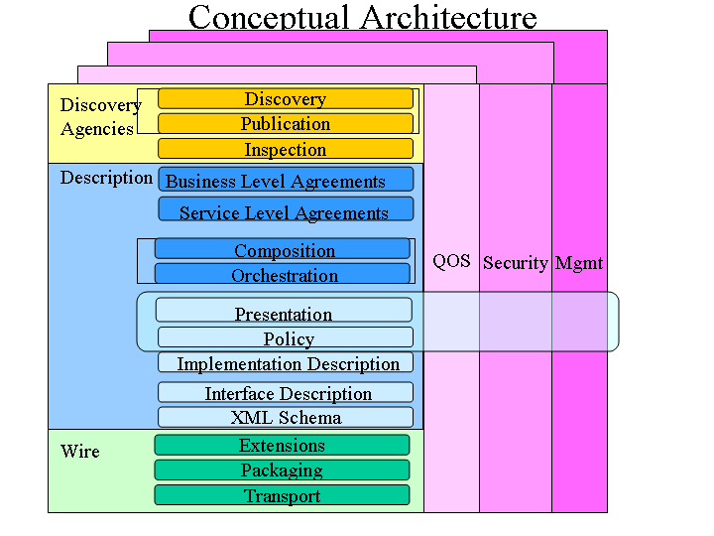
The Complete Web Services "Stack"
More
mature
technologies
Notes:
Independent stacks assembled into a single stack where each additional layer builds upon the capabilities provided by those below it. The vertical towers represent the variety of over arching concerns that must be addressed at every level of each of the stacks.

Slide 83
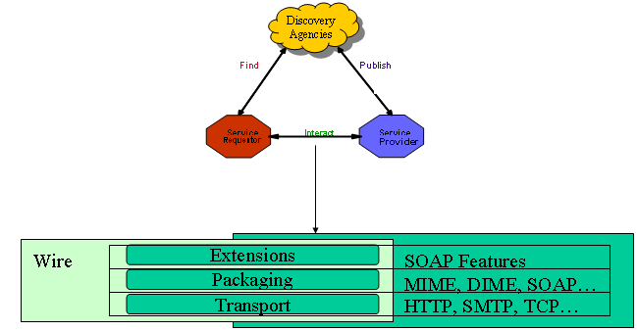
The Wire Stack
SOAP XML messaging over HTTP.
REST Style for HTTP: JSON/XML
Notes:
Transport : Because of its ubiquity, HTTP is the de facto standard network protocol for Internet-available web services. Other Internet protocols may be supported including SMTP and FTP.
Packaging : Packaging, represents the technologies that may be used to package information being exchanged.
XML has been broadly adopted as the basis for Web service message packaging protocols and SOAP is currently the de facto standard for XML messaging.
Extensions : Provides a framework that allows additional information to be attached to Web service messages representing a variety of additional concerns; such as context, routing, policy, etc. SOAP defines a mechanism to incorporate orthogonal extensions (also known as features) to the message in the form of headers and encoding rules.

Slide 84
WS SOAP VS REST
A SOAP service (WS-) has a single endpoint that handles all the operations – therefore it has to have an application-specific interface.
A RESTful service has a number of resources (the collection, each entry), so the operations can be distributed onto the resources and mapped to a small uniform set of operations.

Slide 85
Message-Oriented Middleware (MOM)
Communication using messages
Messages stored in message queues
message servers decouple client and server
Various assumptions about message content
Client App.
Server App.
Message Servers
local message
queues
message
queues
local message
queues
Network
Network
Network

Slide 86
Example: Publish/Subscribe “Messages Oriented Middleware”
Achieved by publish/subscribe paradigm
Idea: Entities can publish data under certain names
Entities can subscribe to updates of such named data
Conceptually: Implemented by a MOM (software bus)
Software bus stores subscriptions, published data; names used as filters; subscribers notified when values of named data changes
Publisher 1
Software bus
Publisher 2
Variations
Topic-based P/S – inflexible
Content-based P/S – use general predicates over named data
Subscriber 1
Subscriber 2
Subscriber 3
Source: Holger Karl, Andreas Willig, Protocols and Architectures for Wireless Sensor Networks, Protocols and Architectures for Wireless Sensor Networks, chapter 12, Wiley, 2005 .

Slide 87
Properties of MOM
Asynchronous interaction
Client and server are only loosely coupled
Messages are queued
Good for application integration
Support for reliable delivery service
Keep queues in persistent storage
Processing of messages by intermediate message server(s)
May do filtering, transforming, logging, …
Networks of message servers
Natural for database integration

Slide 88
First MOM Implementations IBM MQ
https://www.ibm.com/docs/en/ibm-mq/8.0?topic=overview-introduction-mq
One-to-one reliable message passing using queues
Persistent and non-persistent messages
Message priorities, message notification
Queue Managers
Responsible for queues
Transfer messages from input to output queues
Keep routing tables
Message Channels
Reliable connections between queue managers
Messaging API:
MQopen | Open a queue
MQclose | Close a queue
MQput | Put message into opened queue
MQget | Get message from local queue

Slide 89
First MOM Implementations : Java Message Service (JMS)
API specification to access MOM implementations
Two modes of operation *specified*:
Point-to-point
one-to-one communication using queues
Publish/Subscribe
cf. Event-Based Middleware
JMS Server implements JMS API
JMS Clients connect to JMS servers
Java objects can be serialised to JMS messages
A JMS interface has been provided for MQ
pub/sub (one-to-many) - just a specification?

Slide 90
Disadvantages of the first MOMs
Poor programming abstraction (but has evolved)
Rather low-level (cf. Packets)
Request/reply more difficult to achieve, but can be done
Message formats originally unknown to middleware
No type checking (JMS addresses this – implementation?)
Queue abstraction only gives one-to-one communication
Limits scalability (JMS pub/sub – implementation?)

Slide 91
Event-Based Middleware a.k.a. Publish/Subscribe
Publishers (advertise and) publish events (messages)
Subscribers express interest in events with subscriptions
Event Service notifies interested subscribers of published events
Events can have arbitrary content (typed) or name/value pairs
publish
subscribe
Publisher
notify
Subscriber
Event Service
(event-broker
network)
subscribe
Publisher
publish
Subscriber
notify
subscribe
Publisher
publish
Subscriber
notify

Slide 92
Properties of Publish/Subscribe
Asynchronous communication
Publishers and subscribers are loosely coupled
Many-to-many interaction between pubs. and subs.
Scalable scheme for large-scale systems
Publishers do not need to know subscribers, and vice-versa
Dynamic join and leave of pubs, subs, (brokers - see lecture DS-8)
(Topic and) Content-based pub/sub very expressive
Filtered information delivered only to interested parties
Efficient content-based routing through a broker network

Slide 93
Composite Event Detection (CED)
Content-based pub/sub may not be expressive enough
Potentially thousands of event types (primitive events)
Subscribers interest: event patterns (define high-level events, ref DS-2)
Event Patterns
PrinterOutOfPaperEvent or PrinterOutOfTonerEvent
Composite Event Detectors (CED)
Subscribe to primitive events and publish composite events
Publisher
CED
Subscriber
Publisher
CED
Publisher
CED
Subscriber
Publisher

Slide 94
AMQP OASIS Advanced Message Queuing Protocol

Slide 95
Kafka Vs Logstash
Qu'est-ce que Kafka ?
Système de messagerie pub-sub distribué, tolérant aux pannes et à haut débit. Kafka est un service d'enregistrement des engagements distribué, partitionné et répliqué. Il offre les fonctionnalités d'un système de messagerie, mais avec une conception unique.
Qu'est-ce que Logstash ?
Collecter, analyser et enrichir les données. Logstash est un outil de gestion des événements et des journaux. Vous pouvez l'utiliser pour collecter les journaux, les analyser et les stocker en vue d'une utilisation ultérieure (par exemple, pour une recherche). Si vous les stockez dans Elasticsearch, vous pouvez les visualiser et les analyser avec Kibana.

Slide 96
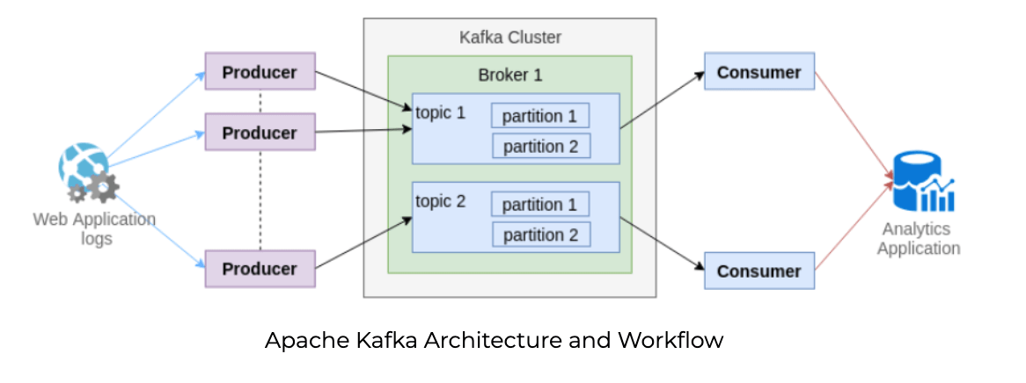
Apache Kafka
Apache Kafka is a distributed data store optimized for ingesting and processing streaming data in real-time
Publish and subscribe to streams of records
Effectively store streams of records in the order in which records were generated
Process streams of records in real time

Slide 97
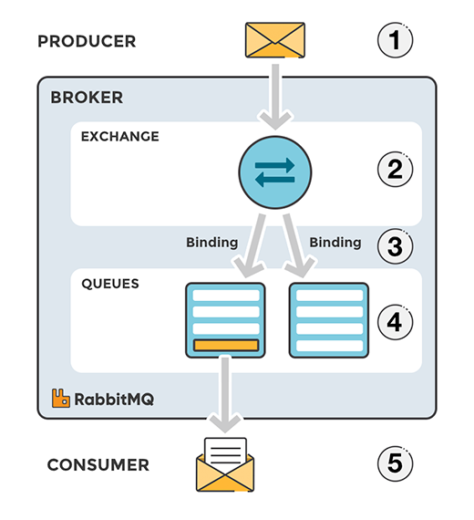
RabbitMQ
RabbitMQ is one of the most popular open source message brokers.
RabbitMQ is lightweight and easy to deploy on premises and in the cloud.
It supports multiple messaging protocols.
RabbitMQ can be deployed in distributed and federated configurations to meet high-scale, high-availability requirements.

Slide 98
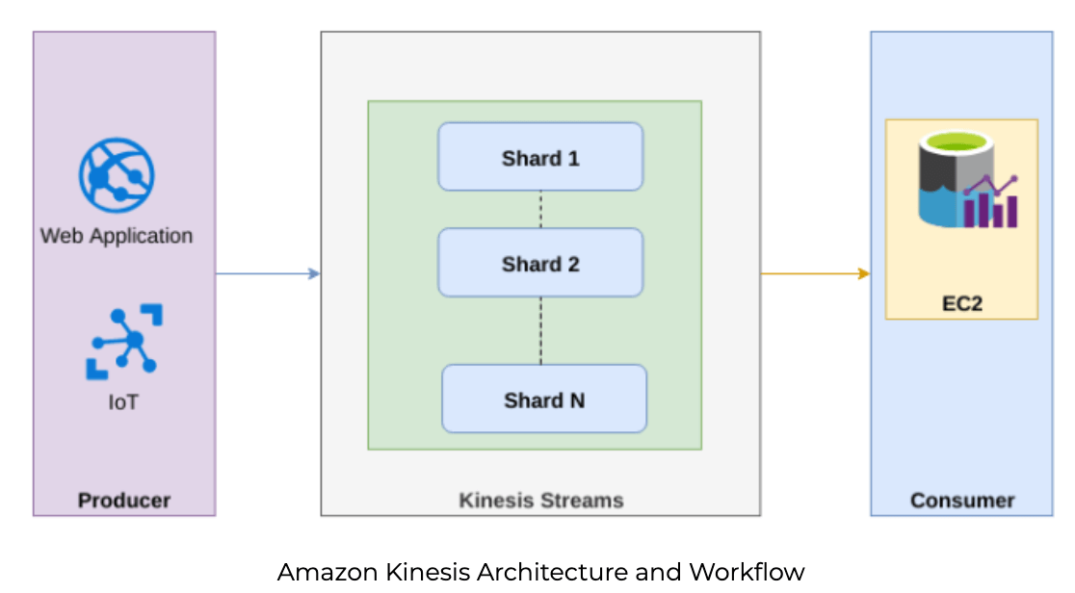
Amazon Kinesis
Amazon Kinesis is a real-time data streaming service that captures data from various sources, including operating logs, social media feeds, website clickstreams, financial transactions, etc.

Slide 99
AMQP is Message Oriented Middleware (MOM)
Transfers application data units from senders to receivers – layer 7
An expectation that the message transfer is via trusted intermediaries
An expectation that messages will be delivered unchanged
An expectation of security
Applications can be separated by (large amounts) of space and time
Abstract from the underlying technology
Physical network limits should be hidden (message size, node location)
Technology concerns should be hidden (platform, language, OS)
The intermediaries offer various delivery options, as defined by either the sender or the receiver (s)
The intermediaries provided various defined qualities of service for the sender and the receiver (s)
Provide stability and backwards compatibility (10yrs+)

Slide 100



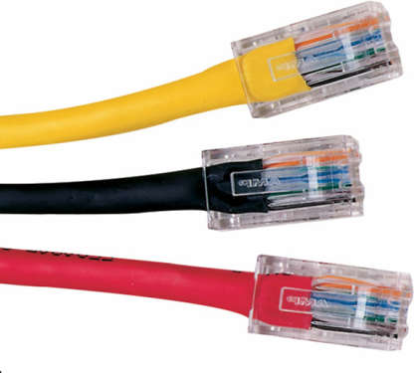


AMQP 1.0 Covers…
Queuing with strong Delivery Assurances
Event distribution with Flexible Routing
Large Message capability (gigabytes)
Global Addressing Scheme (email-like)
Meet common requirements of mission-critical systems
Publish/ Subscribe
detect
Messaging
transact
File Transfer
report

Slide 101
AMQP 1.0 Model Entities
The following entities are discoverable in any full AMQP 1.0 implementation:

Slide 102
What Happened to Exchanges?
Upon reflection, exchanges were redundant
Global Addressing drove the change
Need one abstract name to route, need to hide implementation details
Exchanges/Exchange Instance/Exchange type were “leaky abstractions”
Exchange == Queue -> Links -> Queues
Input Queue provide an abstract Address
Links contain a Function to evaluate Messages
Function parameterised by the Link predicates
Output Queue = Link( message, predicates)
New approach is more abstract and more flexible
Moves complexity from Clients to Brokers
Simpler to implement and use
Lots of opportunity to differentiate

Slide 103
AMQP is an Overlay Network
Broker
Applications Connect to a Broker to participate in the AMQP network
The Connection is used to establish a Session
Sessions provide state between Connections, establish identity, ease failover
Connections are further subdivide into Channels
Multiple threads of control within an Application can share one Connection
Queues
Applications logic interacts ONLY with Queues
Queues have well known Names == Addressable
Applications do not need to know how messages get in/out of Queues
Queues can be smart, they are an extension point
Applications will assign implied semantics to Queues (e.g. “StockOrderQueue”)
Links
Links move Messages between Queues and/or Applications
Contain Routing and Predicate Evaluation Logic – similar to Complex Event Processing

Slide 104
The AMQP Network
An AMQP Network consists of Nodes and Links.
A Node is a named source and/or sink of Messages.
Messages travel between Nodes along named, unidirectional Links.
Link
Source Node
Target Node

Slide 105
Types of Links
Destructive: the transfer along the link removes the message from the source
Destructive: the transfer along the link removes the message from the source
Destructive: the transfer along the link removes the message from the source
Destructive: the transfer along the link removes the message from the source
Non- Destructive: the message remains at the source node, and is “copied” to the destination.
A
A
A
A
B
B
B
B
C
C
C
C

Slide 106
Messages
Messages consist of parseable Properties and an opaque Body.
Messages may not be mutated by the AMQP Network.
The network carries information about the Message in Headers and Footers.
Header and Footer values may be modified in the Network.

Slide 107
Message Identity
A Message is assigned a globally unique identifier.
Nodes which perform transformations are creating new Messages, with new ids.
Only one “copy” of a Message can ever exist at a Node.

Slide 108
Filters
Each Link may have a Filter which evaluates which messages may travel along it.
Filters are evaluated against immutable properties of the Message.
Filter syntax determined by the Filter Type, e.g. SQL, XQuery
color = 'red'
color = 'yellow'

Slide 109
Inter-Network Connectivity

Slide 110
Inter-Company Firewalls

Slide 111
Some Typical Usage Patterns

Slide 112
Point-to-point Queue Delivery
AMQP Broker
Client
Producer
Session
Link
Tail
Entry 3
Entry 2
Session
Client Consumer
Entry 1
Head
Link
Queue (source) -Persistent
Highlights:
Only “Source” queue is required and can be read directly by consumer over Link (i.e. dedicated consumer Worker queue and bridging between Source and Worker unnecessary).

Slide 113
Abstracted Point-to-point Queue
AMQP Broker
Client
Producer
Session
Tail
Link
Tail
Entry 3
Entry 2
Link
Entry 2
Entry 1
Head
Entry 1
Head
Queue (Source) -Persistent
Queue (worker) -Persistent
Highlights:
One Queue performs the role of holding the “Well Known” name for the outside world.
All messages are automatically forward on to the real worker queue.
Allows internal topology to change without the outside world seeing (this PO Box)

Slide 114
Load-Balanced Point-to-point Queue Delivery
AMQP Broker
Client
Producer
Session
Session
Client Consumer
Link
Tail
Entry 3
Link
Entry 2
1 Head or 2 ?
Entry 1
Queue (source) -Persistent
Session
Client Consumer
Link

Slide 115
Dynamic (non-persistent) Pub/Sub Delivery
AMQP Broker
Client Subscriber
Session
Link
Client
Publisher
Session
Link
Tail
Entry 3
Head
Entry 2
Head
Session
Client Subscriber
Entry 1
Head
Link
Queue (Source) -Non-persistent
Session
Client Subscriber
Link
Highlights:
Messages are “garbage collected” in an implementation specific manner after delivery.
AMQP makes some guarantees about how long messages are valid for.

Slide 116
Durable (persistent) Pub/Sub Delivery
AMQP Broker
Tail
Session
Client Subscriber
Link
Entry 2
Head
Client
Publisher
Session
Tail
Link
Entry 1
Link
Entry 3
Queue (Worker) - persistent
Entry 2
Head
Entry 1
Head
Queue (Source) - persistent
Link
Client Subscriber
Session
Entry 1
Head
Link
Queue (Worker) - persistent

Slide 117
AMQP Famous Implementations
ActiveMQ implements AMQP. License: Apache
Recent vulnerabilities: CVE-2016-3088, CVE-2016-0782 , CVE-2016-0734, CVE-2015-5254
Alternatives to ActiveMQ
RabbitMQ: is developed and maintained by Pivotal. License: MPL, GPL,
Kafka: originally developed by LinkedIn. Currently it is part of Apache Camel project
Kestrel: originally developed by Twitter, but currently with Apache.
QPID Client: Apache QPID is a message queuing solution that aims to fully implement AMQP.

Slide 118
